Slide 1
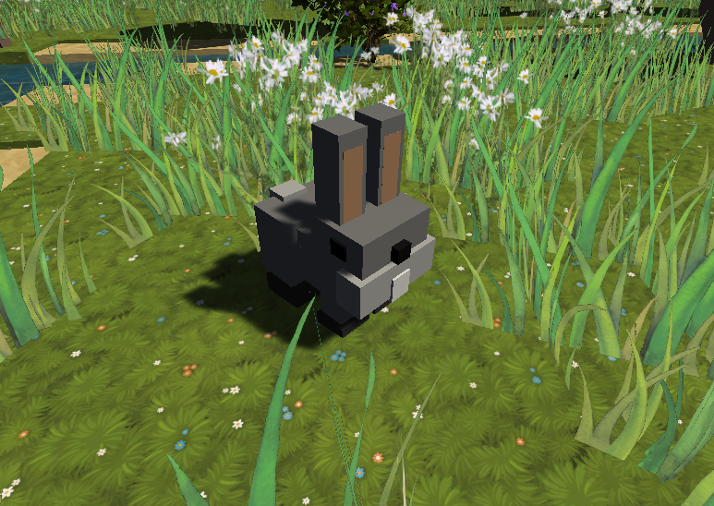
Ecosystem on Your Kitchen Table
Irimia Ioan-David
Popa Vlad
Mitici Alexandru
Alex ?
Axinte Sebastian

Slide 2

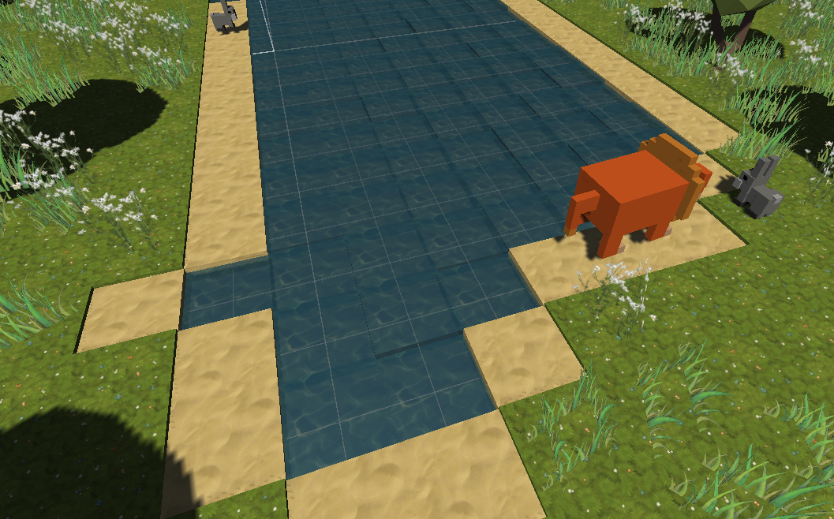
What it is
Pocket-sized ecosystem simulation
Pleasant, low-poly graphics
Ever-adapting animals

Slide 3
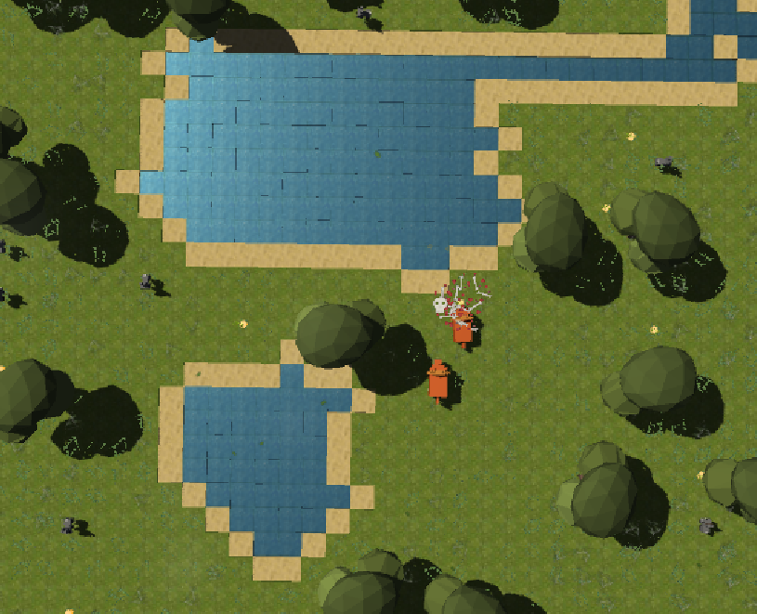
Features
Augmented Reality
Infinite ecosystem
Bunnies and Foxes AI
Evolution through natural selection
Procedurally generated environment
Dynamic wind
No servers or setup required

Slide 4
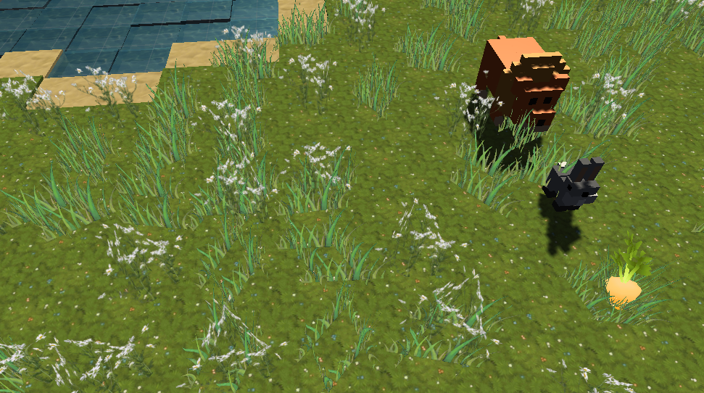
Ecosystem Flow
Rabbits eat plants
Foxes eat rabbits
Plants spawn randomly and when animals die
Animals can die of hunger

Slide 5



Technologies
Unity 3D
C#
Photoshop

Slide 6
SOLID
SRP – Responsible for only 1 thing
Spawner spawns, Prefabs holds prefabs...
OCP – AnimalScript can be extended, but not modified
AnimalScript is independent of its subclasses
LSP – A fox can replace a rabbit at any time and it will work
ISP – Our code is interface-free
DIP – C# in Unity is already high level
Lower level code is not directly called by high level functions

Slide 7
Design Patterns
Singleton – PlaneScript, Prefabs, Materials, etc
'Private constructor' in the Start method of the MonoBehaviour
Public get-only static instance
Factory class / functions – Spawner.cs
Instantiates objects
Prototype – Unity prefab system is based on prototypes
Flyweight Design – All tiles use the same three materials

Slide 8
Architecture
Layered map generation
Map generation flows through multiple layers
Microkernel Architecture (kind of)
Current systems can be enhanced with additional modules

Slide 9
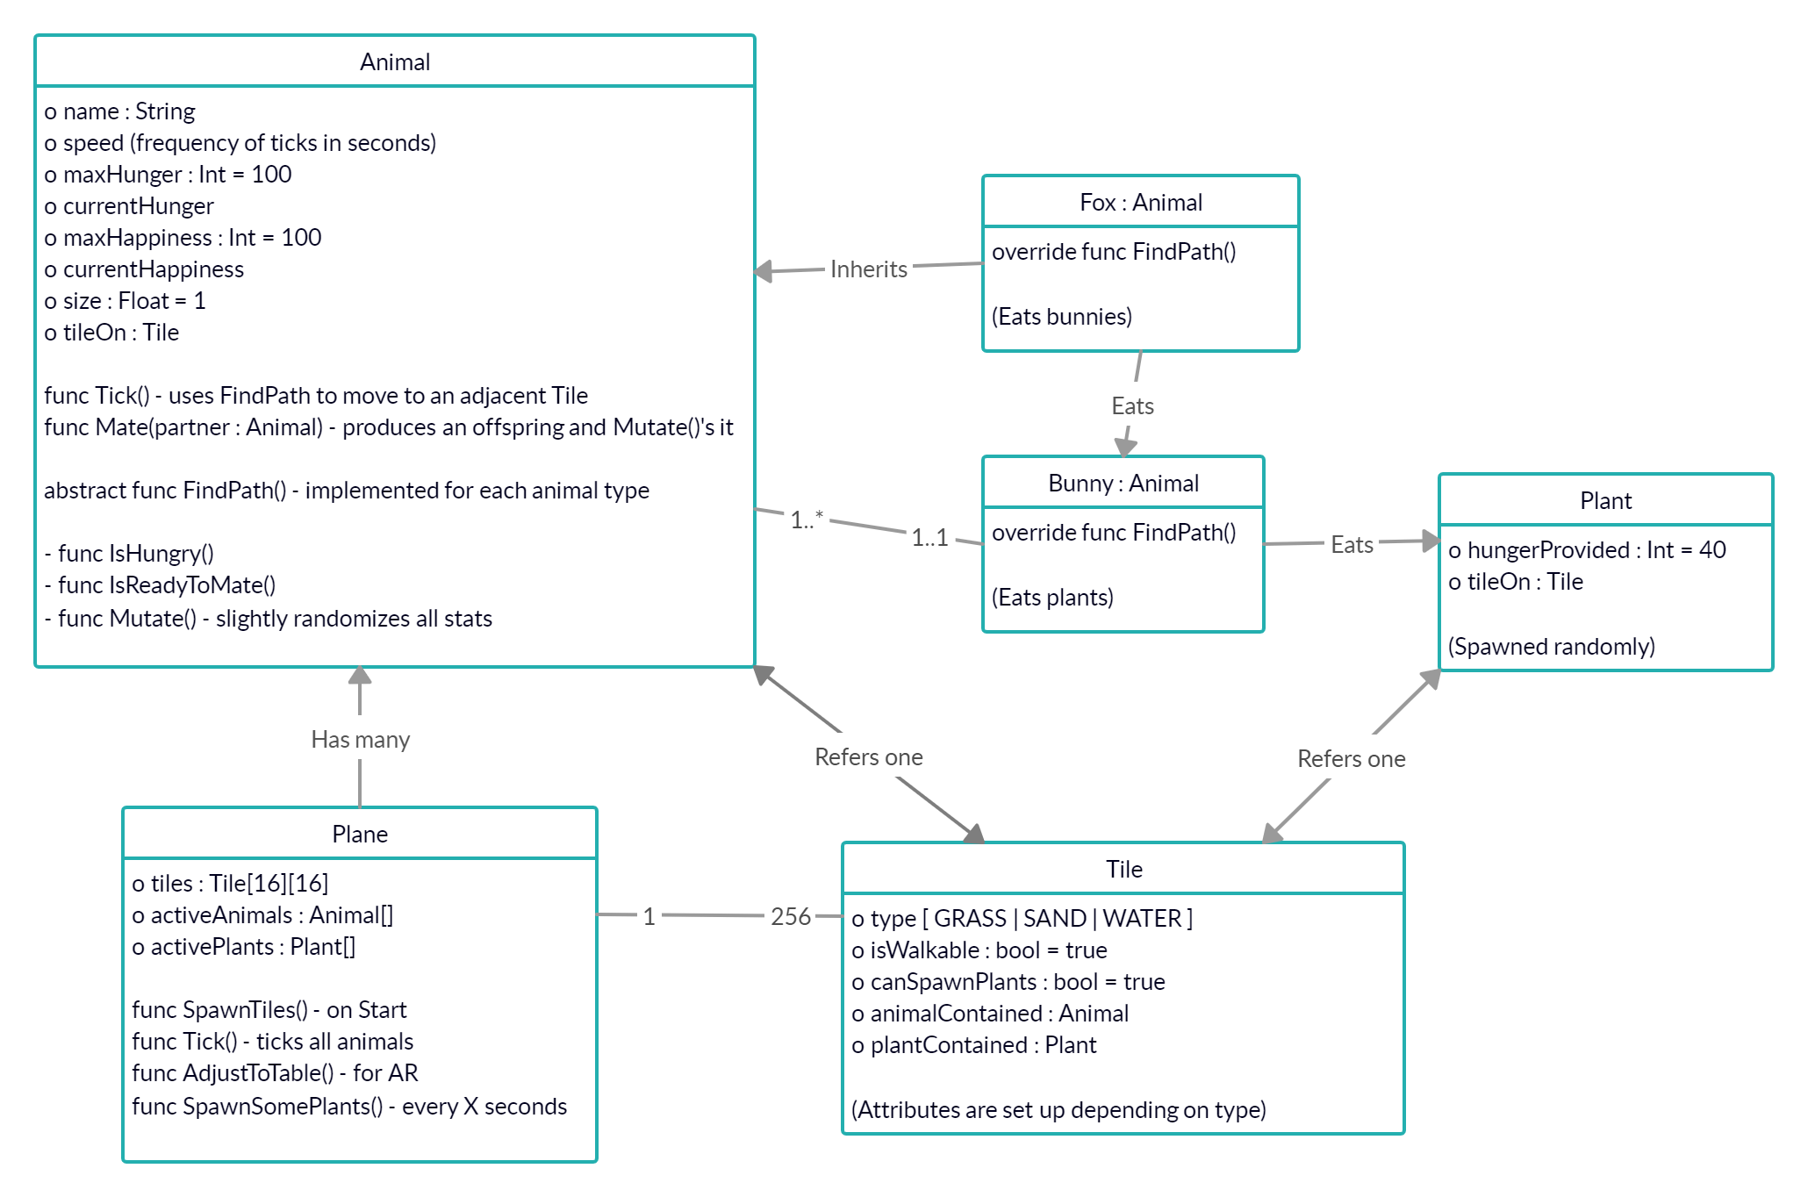
Code Structure Diagram

Slide 10
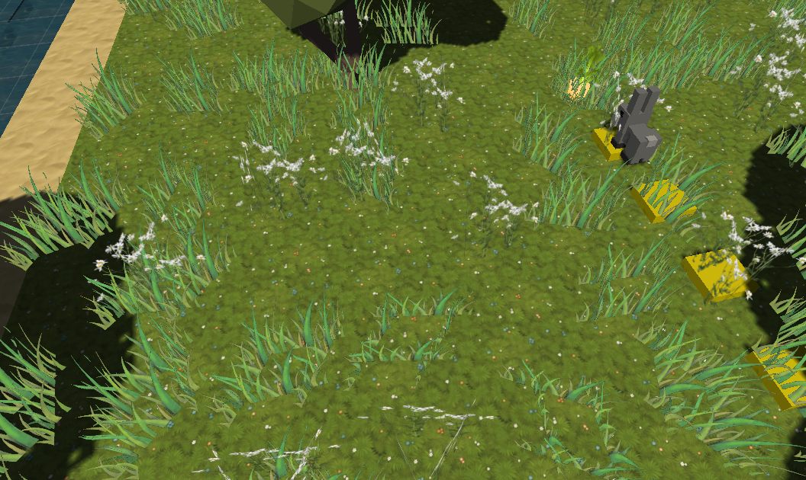
Pathfinding
Breadth First Search
Each tile holds a pointer to the previous tile
(during the algorithm only)
Backtracks when it finds a match

Slide 11
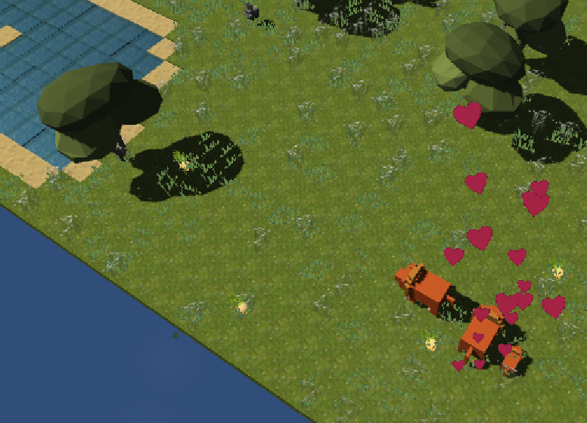
Evolution
Offsprings inherit the average of parents' stats...
...and then mutates!
Up to 20% stat alterations (-10% / +20%)

Slide 12
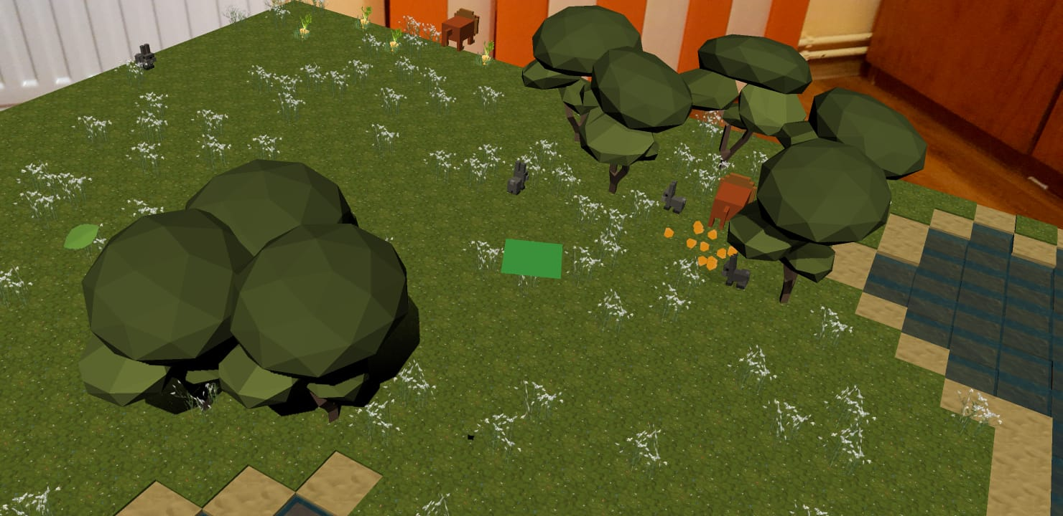
Augmented Reality
Unity AR system builds a 3D scene
Raycast from camera to screen center
Marker is placed at collision point
Moving in circular motion helps building the hidden 3d scene faster
Scene movement according to real movement is handled by Unity AR

Slide 13
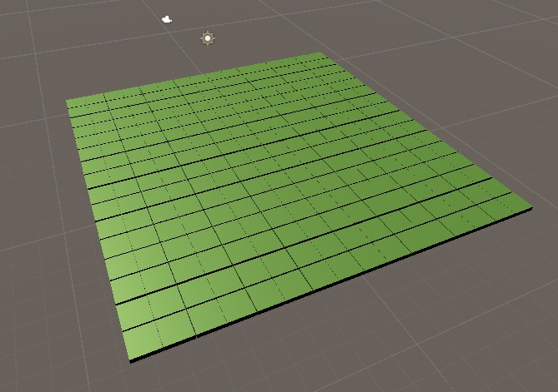
Map Generation
Creates maxNumberOfLakes lakes of size maxLakeSize with centers at random points
The higher the w (0 to 100), the higher the chance to spawn extra sand
Extra lonely sand is cleared afterwards
Trees at random positions on grass

Slide 14
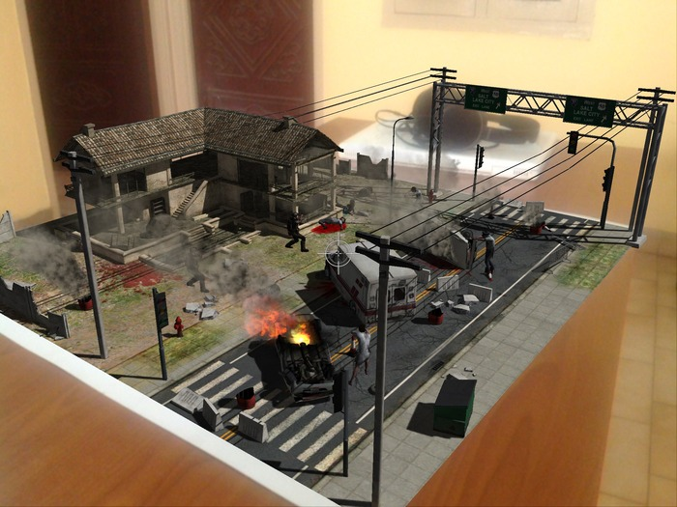
Inspiration
Minecraft
TableZombies
Coding Adventure: Simulating
an Ecosystem (by Sebastian Lague)
Knightfall
etarteco

Slide 15
Resources
Low Poly Trees
Grass Flowers
Handpainted Forest (grass)
Root Vegetables
Voxel Animals

